Slide 1
Work report
Ziyu Tao

Slide 2
content
Signature biomarker to predict immunotherapy response
Copy number signature

Slide 3
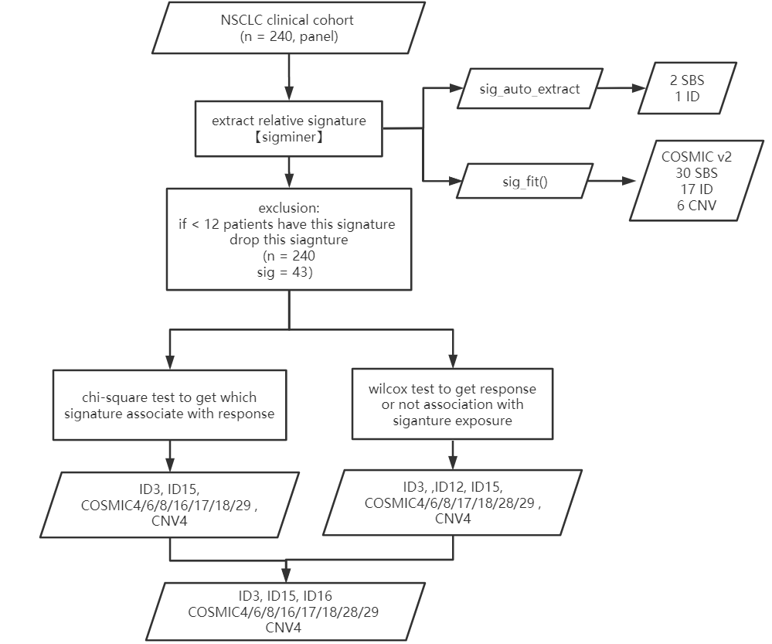
How to filtrate signatures (done)

Slide 4
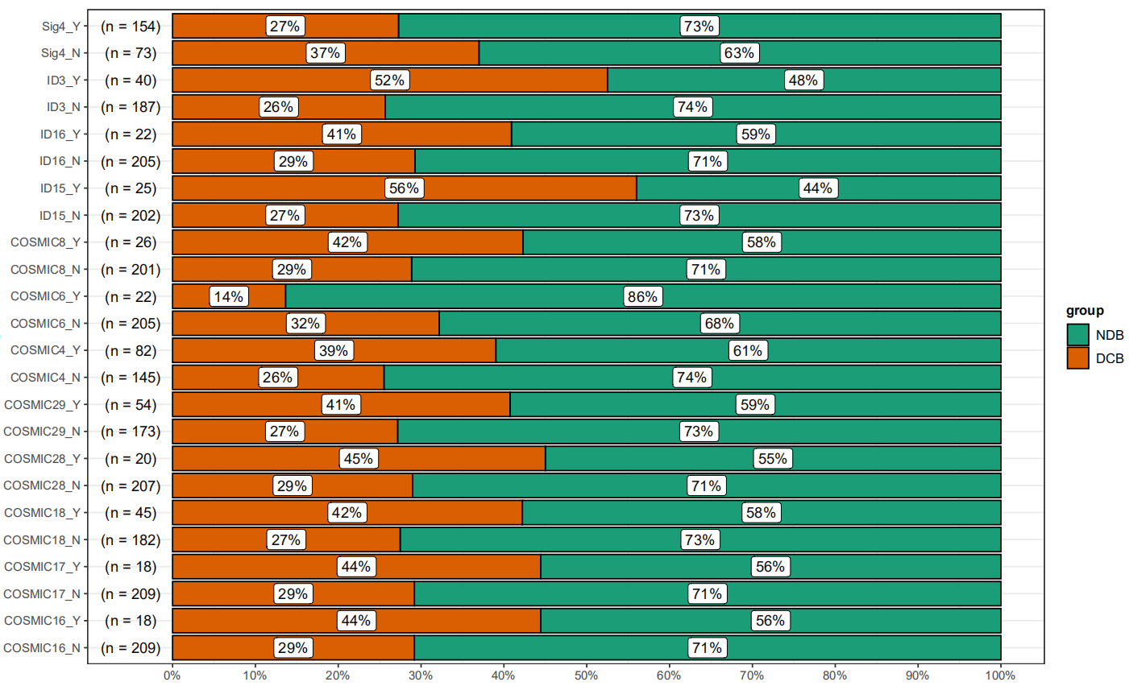
Signature with response or not
每个signature病人分为反应或不反应
简单看一下数量

Slide 5
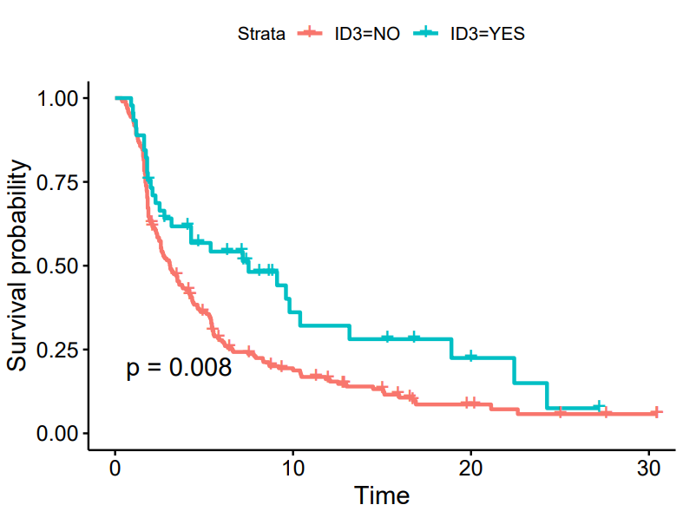
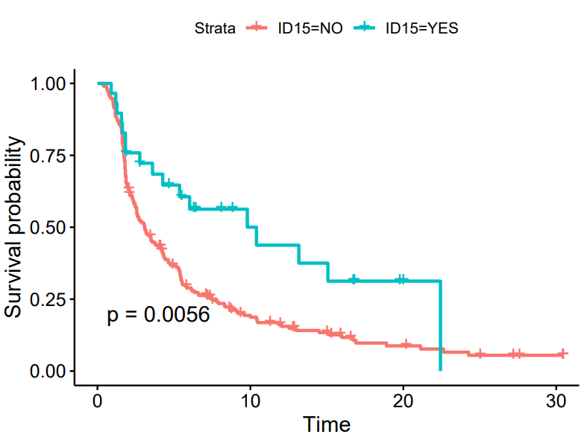
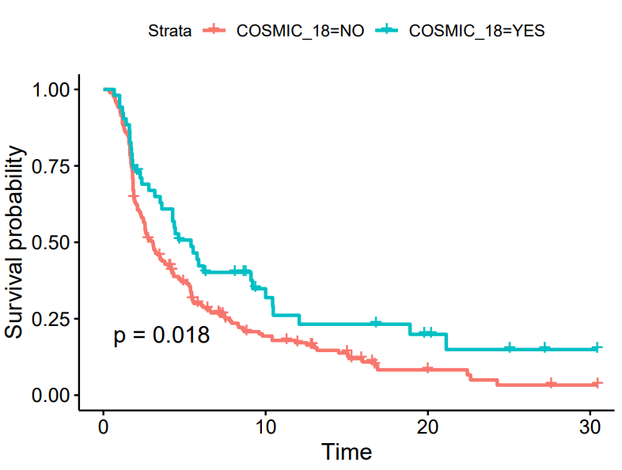
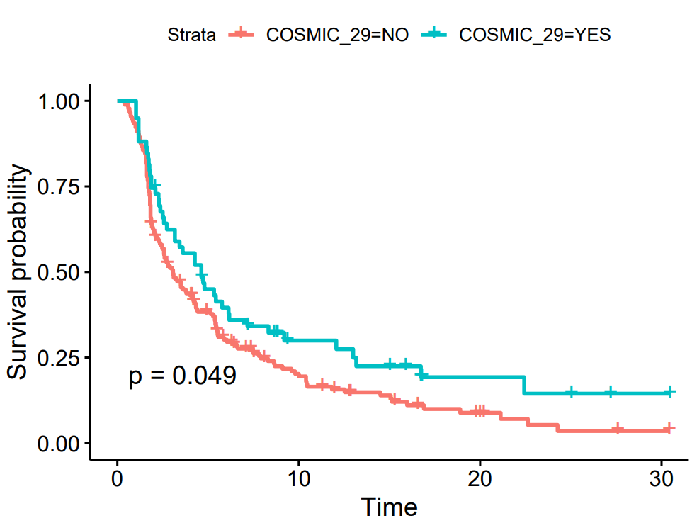
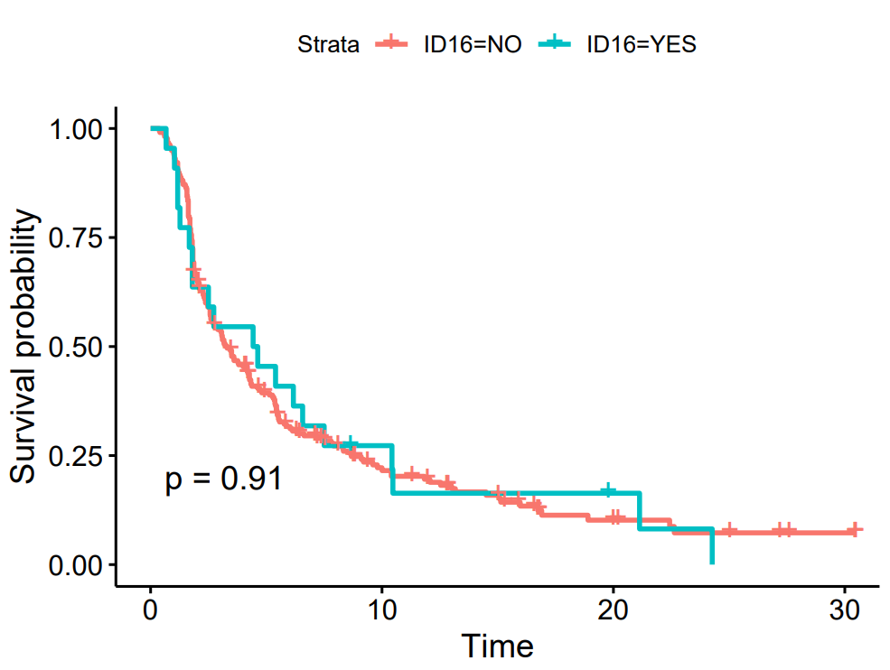
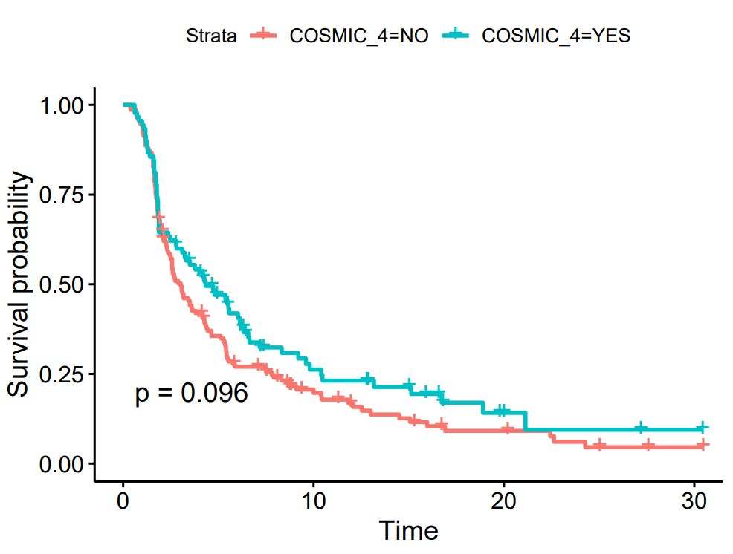
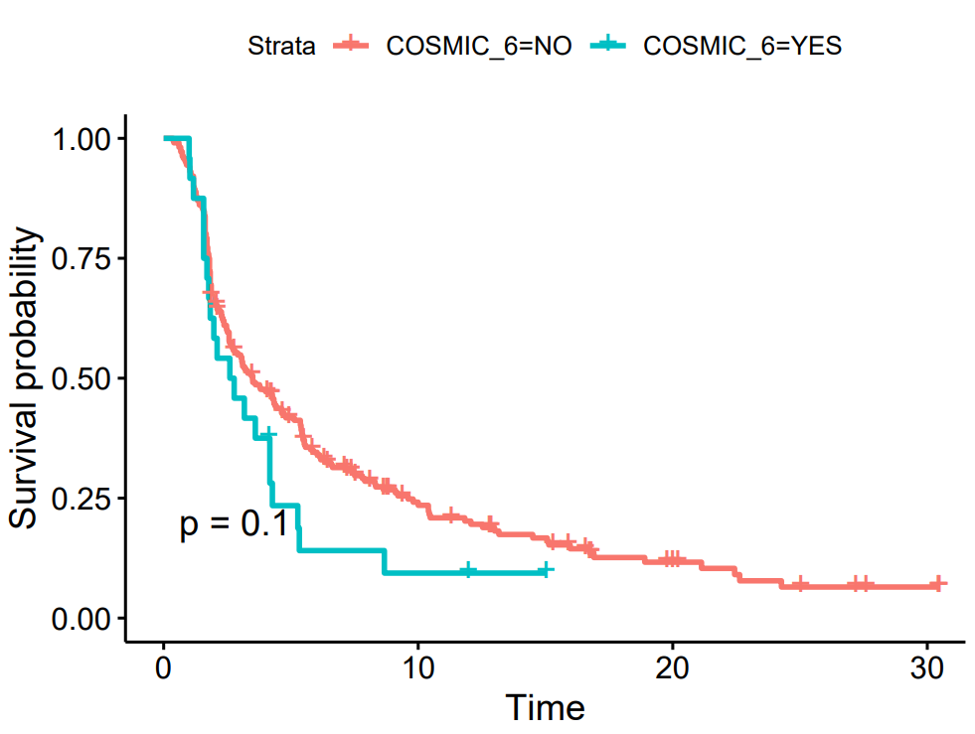
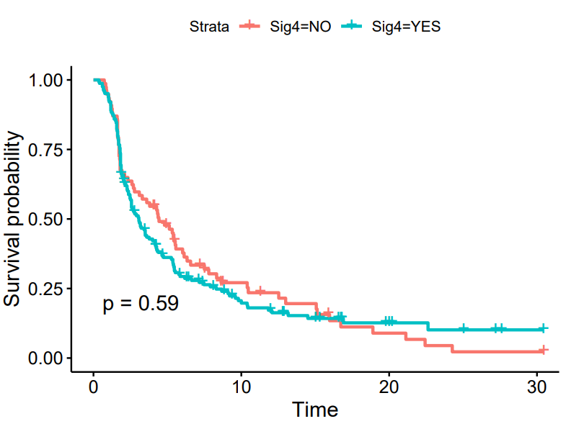
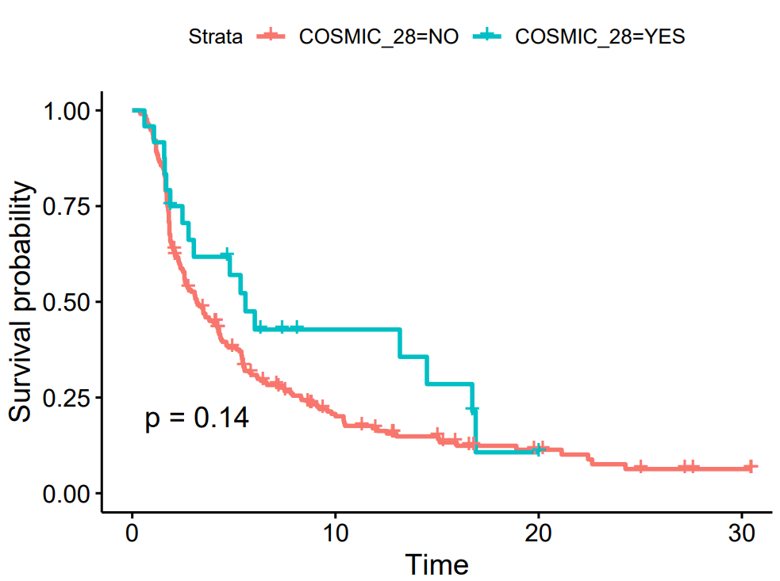
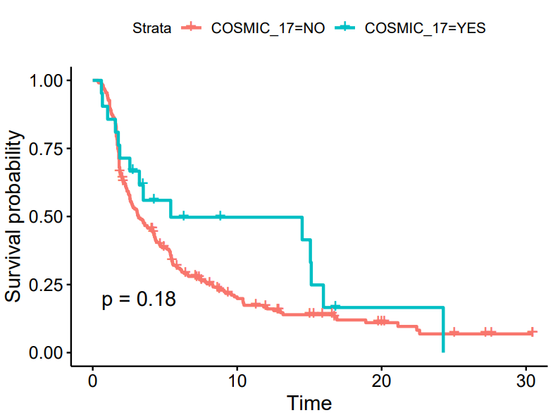
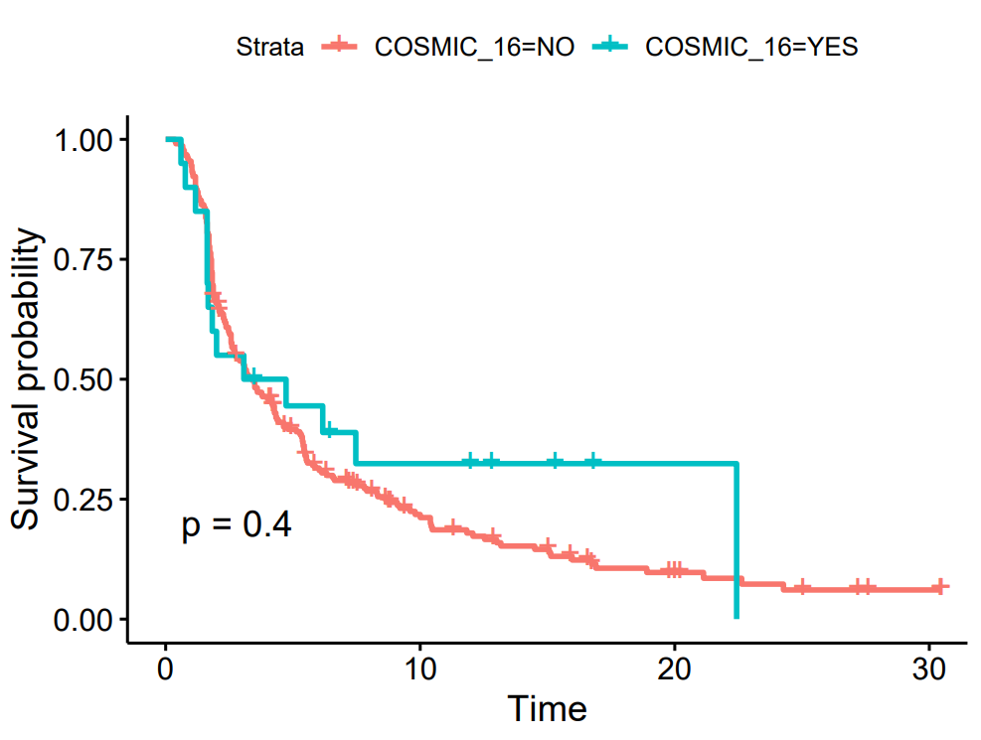
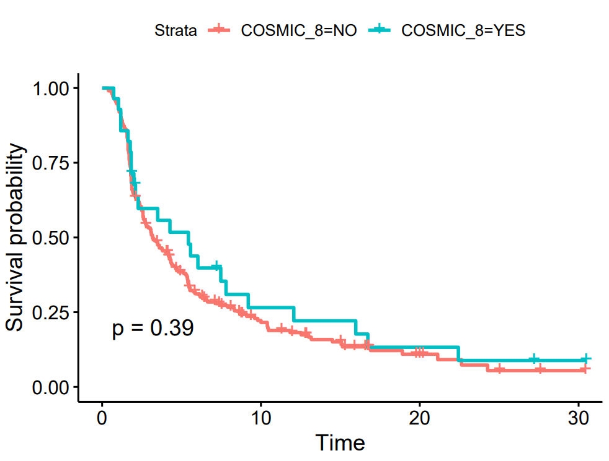
PFS单因素cox分析筛选显著的signature
ID3， ID15， COSMIC18， COSMIC29

Slide 6
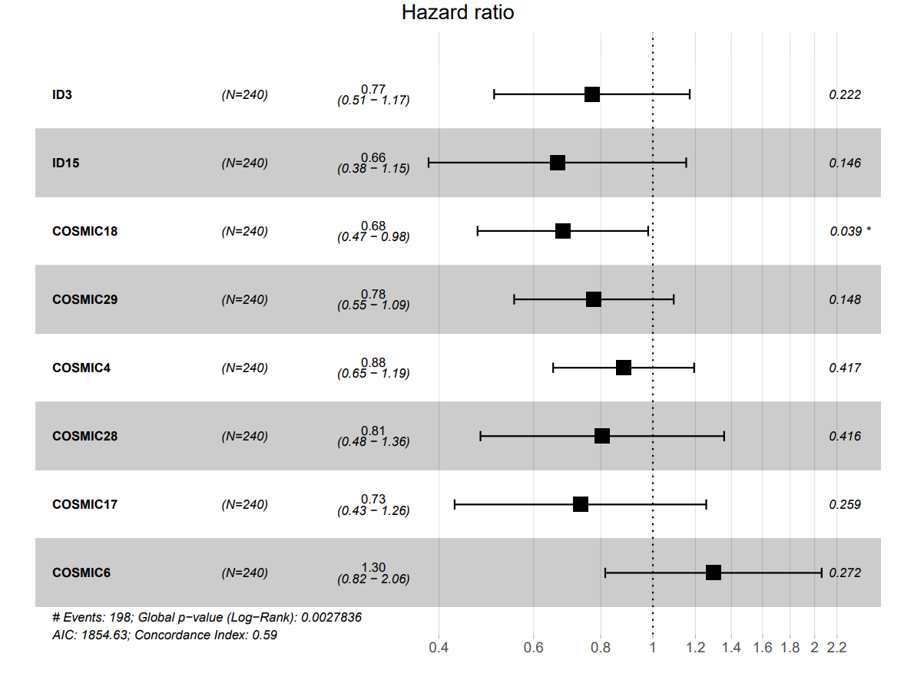
Signature modeling 多变量cox分析不同signature风险水平
Signature 6 is associated with defective DNA mismatch repair and is found in microsatellite unstable tumours.
The aetiology of Signature 18 remains unknown.

Slide 7
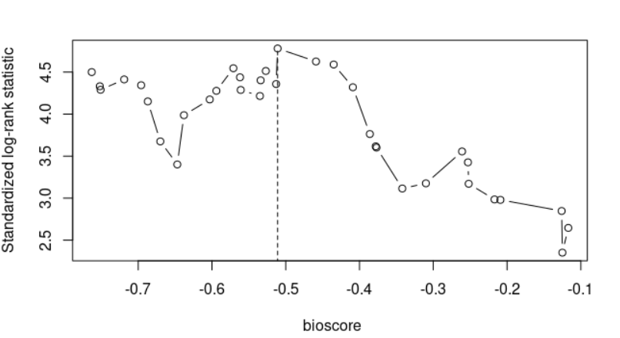
bioscore
-0.511
bioscore= 0.2595 * COSMIC6 –(0.261*ID3 + 0.409*ID15 + 0.386*COSMIC18 + 0.252*COSMIC29 + 0.125*COSMIC4 + 0.217*COSMIC28 + 0.310*COSMIC17)
Cut-off = -0.511

Slide 8
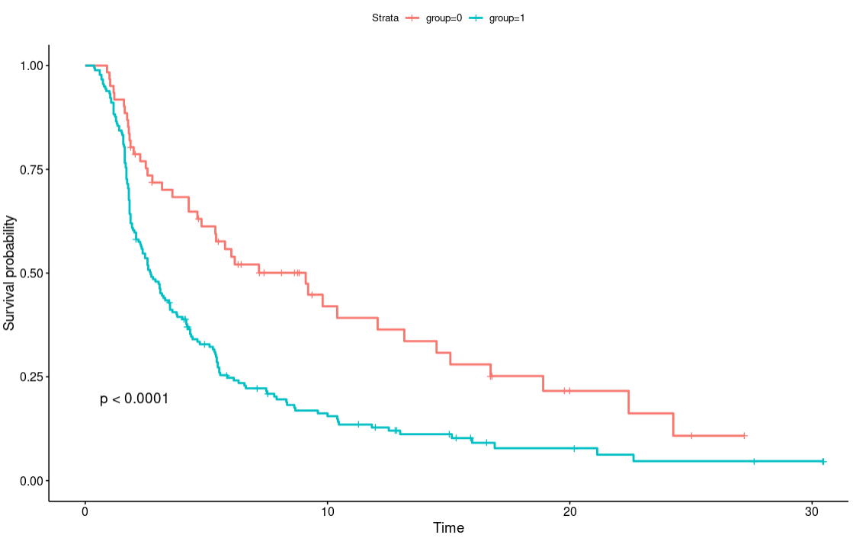
Predict function
group1
>= -0.511
group2
<-0.511

Slide 9
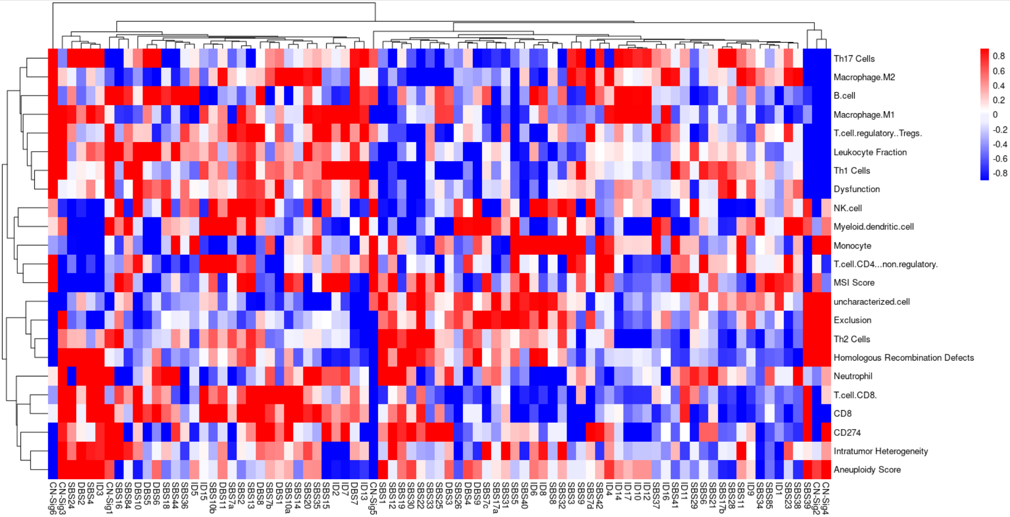
TCGA with immune

Slide 10
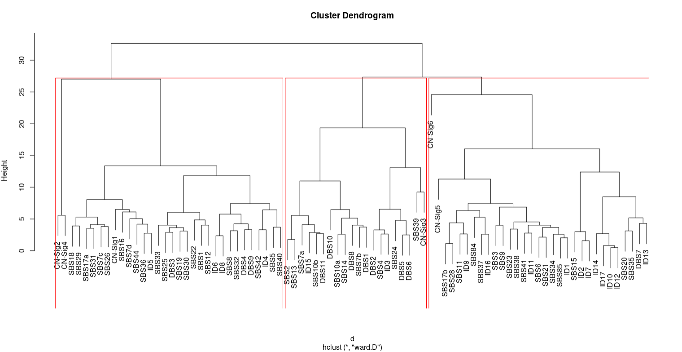

Slide 11
Copy number signature
本周日前完成细分类

